Slide 1
Welcome To My Presentation

Slide 2
Presentation on Transmitter of Basic Monochrome Television System
Submitted To
MD. Imran Hossain
Assistant Professor
Department of ICT
Comilla University
Submitted by
Kurshed Alam
ID:11809046
Department of ICT
Comilla University

Slide 3
Outlines of Presentation
Basics of Monochrome TV Transmitter
Block Diagram of Monochrome TV Transmitter
Component of Monochrome TV Transmitter
Working of Monochrome TV Transmitter
Parameters of Monochrome TV Transmitter

Slide 4
Basics of Monochrome TV Transmitter
Elementary area which picture detail may be broken is known as picture element.
Information is given as a function of two variable , space and time.
Ideally, there is infinite elements of information in optical domain.
Its function is to convert optical image of television scene into electrical signal by the scanning process.
Scanning of element is done at a very fast rate and this process is repeated a large number of times per second to create an illusion of simultaneous pick up and transmission of picture details.

Slide 5
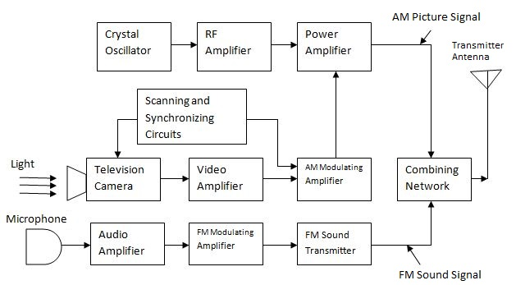
Block Diagram of Monochrome TV Transmitter

Slide 6
Its important parts are as follows
T.V camera- T.V The camera is a device that converts optical images into electrical signals. Hence TV The amplitude of the signal received from the camera changes according to the light intensity of the scene
Video amplifier- The main function of a video amplifier is to increase the voltage level of the composite video signal, so that the voltage label of the composite video signal can be increased to the transmittable level. The output of this section is a fully prepared composite video signal for transmission.
Camera amplifier- TV The electrical signal received at the output of the camera is very weak, which needs to be amplified. Hence TV Camera Amplifier Functions The electrical signal from the camera is to be amplified
Deflection and A. P. Generation- The main function of this unit is to provide oscillators to provide horizontal and vertical deflection in the camera tube, and synchronization and Blanking Plus are also provided by this unit. Hence it provides system scanning as well as system synchronization.
Audio amplifier- Audio amplifier is used to increase the voltage label of the audio Signal and a loud speaker is also used to check the audio signal at this stage.

Slide 7
Its important parts are as follows
M.F Modulator- F. M . The major function of the modulator is to modulate the frequency of the output signal received from the pre-emphasis circuit (pre-emphasis ckt).
Power amplifier- Modulated R. F . The power of the modulated signal received from the amplifier is not sufficient for transmission. Therefore, the signal received from this stage is fed into the power amplifier. So that the power level of the signal can be increased.
R.F amplifier- The signal coming in this stage is negatively coupled to the carrier signal R. M . Modulator. Crystal oscillator of carrier signal, frequency multiplier and R.F . Is provided by the multiplier, and the function of this unit is also to increase the signal's video label.
scanning circuit- Its main function is TV. The camera has to be scanned, and the received signal is called AM Modulating amplifier has to be provided as input
Combining network - The use of this network is to combine signals coming from all the circuit networks and provide suitable output, which is transmitted by the transmitter antenna.

Slide 8
Parameters of Monochrome TV Transmitter
It has a video information in between black and white with the shades of gray.
It transmits on channels in the VHF and UHF.
Picture and sound signal are modulated on RF carrier to reduce antenna size

Slide 9
Thanks

